Slide 1
Defining Data Warehouse Concepts and Terminology
Chapter 3

Slide 2
Definition of a Data Warehouse
“ An enterprise structured repository of subject-oriented, time-variant, historical data used for information retrieval and decision support. The data warehouse stores atomic and summary data.”
Oracle Data Warehouse Method

Slide 3
Data Warehouse Properties
Subject Oriented
Integrated
Data Warehouse
Non Volatile
Time Variant

Slide 4
Subject-Oriented
Data is categorized and stored by business subject rather than by application .
OLTP Applications
Data Warehouse Subject
Equity Plans s
Customer
financial information
Shares
Equity InsurancePlans
Savings
Equity Loans Plans

Slide 5
Time-Variant
Data is stored as a series of snapshots, each representing a period of time
Time | Data
Jan-97 | January
Feb-97 | February
Mar-97 | March

Slide 6
Changing Data
First Time Load
Refresh
Operational Database
Refresh
Refresh

Slide 7
Data Warehouse Versus OLTP
Property | Operational | Data Warehouse
Response Time | Sub seconds to seconds | Seconds to hours
Operations | DML | Primarily read only
Nature of Data | 30-60 days | Snapshots over time
Data Organization | Applications | Applications
Size | Small to large | Large to very large
Data Source | Operational, Internal | Operational, Internal, Externa
Activities | Processes | Analysis

Slide 8
Usage Curves
Operational system is predictable
Data Warehouse
- Variable
- Random

Slide 9
User Expectations
Control expectations
Set achievable targets for query response
Set SLAs
Educate
Growth and use is exponential

Slide 10
Enterprisewide Warehouse
Large scale implementation
Scope the entire business
Data from all subject areas
Developed incrementally
Single source of enterprisewide data
Single distribution point to dependent data marts

Slide 11
Data Warehouses Versus Data Marts
Data Warehouse
Data Mart
Property | Data Warehouse | Data Mart
Scope | Enterprise | Department
Subject | Multiple | Single-subject, LOB
Data Source | Many | Few
Size(typical) | 100 GB to>1 TB | <100 GB
Implementation time | Months to years | Months

Slide 12
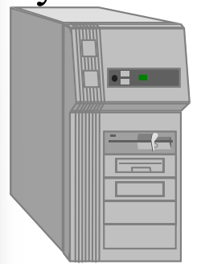
Dependent Data Mart
Flat Files
Operational Systems
Marketing
Marketing
Sales
Finance
Human Resources
Marketing
Data Warehouse
Marketing
External Data
Data Marts

Slide 13
Independent Data Mart
Flat Files
Operational Systems
Sale or Marketing
External Data
External Data

